Slide 1

COMPANY : MEDTOUREASY
MENTOR NAME:
ANKIT HASIJA

Slide 2

COMPANY PROFILE
MedTourEasy, a global corporate healthcare company, provides you the informational resources needed to evaluate your global options. MedTourEasy provides analytical solutions to our partner healthcare providers globally.
Global health is an area for study, research, and practice that places a priority on improving health and achieving equity in health for all people worldwide.

Slide 3

TECHNOLOGY LEARNED
Language : Python
Python is a high-level, general-purpose programming language known for its simplicity and readability. It has a vast ecosystem of libraries and frameworks that make it suitable for various applications, including data analysis and visualization. Some key features of Python for data analysis are:
Libraries
Easy-to-learn syntax
Active community support

Slide 4

TECHNOLOGY LEARNED
Platform: Jupyter Notebook
Jupyter Notebook is an open-source web application that allows you to create and share documents containing live code, visualizations, and narrative text. It provides an interactive computational environment that supports multiple programming languages, with Python being one of the most commonly used languages. Here are some key features of Jupyter Notebook:
Interactive environment
Mix of code and documentation
Rich output
Collaboration and sharing

Slide 5
OUTLINE OF WORK DONE DURING INTERNSHIP
I have learned the following topics during the internship:
What is Data Science? - Basic Overview and Topics
Languages of Data science & Packages, APIs, Datasets and Models
Data Science Lifecycle
Python Data Structures & Working with Data in Python
Introduction to SQL-Data Science & Accessing Databases using Python
Importing Datasets & Data Wrangling
Basic Introduction to Data Visualization Tools & Data Visualization Libraries

Slide 6

IMPLEMENTATION
With the explosion in fitness tracker popularity, runners all of the world are collecting data with gadgets (smartphones, watches, etc.) to keep themselves motivated. This data was exported from Runkeeper (online social fitness community). My project topic is Analysis of Fitness Data. In this project, I'll create import, clean, and analyze the data.
Obtain and review raw data
Data preprocessing
Dealing with missing values
Plot running data
Running statistics
Visualization with averages
Did I reach my goals?
Am I progressing?
Training intensity
Detailed summary report

Slide 7
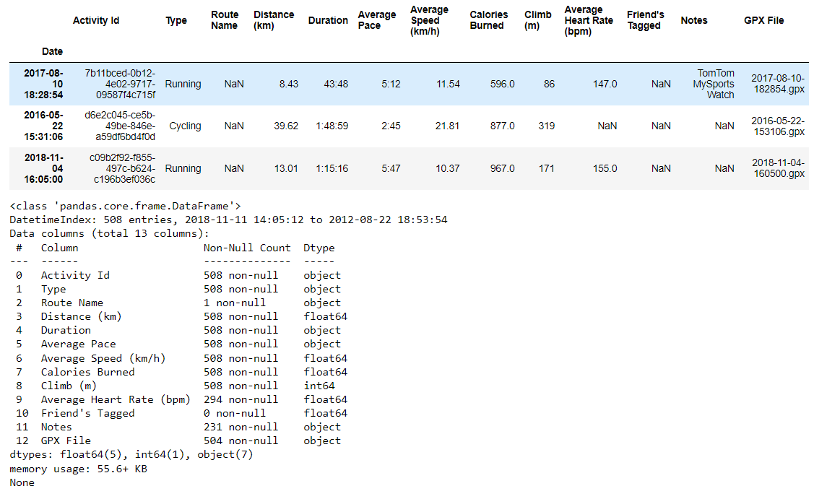
OBTAIN AND REVIEW RAW DATA
SCREENSHOTS

Slide 8
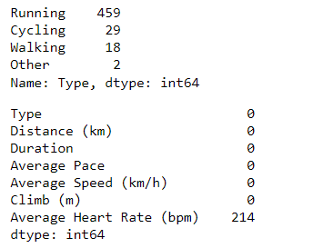
2. DATA PREPROCESSING
SCREENSHOTS

Slide 9
CONCLUSION
The Analysis of Fitness Data project successfully analyzed fitness data using Python and Jupyter Notebook. It provided insights into performance, goal achievement, progress tracking, and training intensity. The project generated visualizations, a detailed summary report, and incorporated fun facts to engage users.
The future scope for the Analysis of Fitness Data project includes integrating additional data sources, exploring machine learning techniques, implementing real-time data analysis, developing a dedicated mobile application with social sharing features, enhancing visualization techniques, analyzing long-term trends, and incorporating user feedback for customization options. These advancements would provide a more comprehensive view of fitness performance, personalized insights, improved user experiences, and the ability to adapt to individual preferences and goals.

Slide 10
REFERENCE
Data Collection
The following websites have been referred to obtain the input data and statistics:
https://runkeeper.com/cms/
https://www.kaggle.com/datasets/yassershrief/cardio-activities
Programming References
The following websites have been referred for Python tutorials:
https://www.w3schools.com/datascience/
https://www.javatpoint.com/data-science
https://www.geeksforgeeks.org/data-science-tutorial/
https://www.tutorialspoint.com/python_data_science/index.htm

